Slide 1
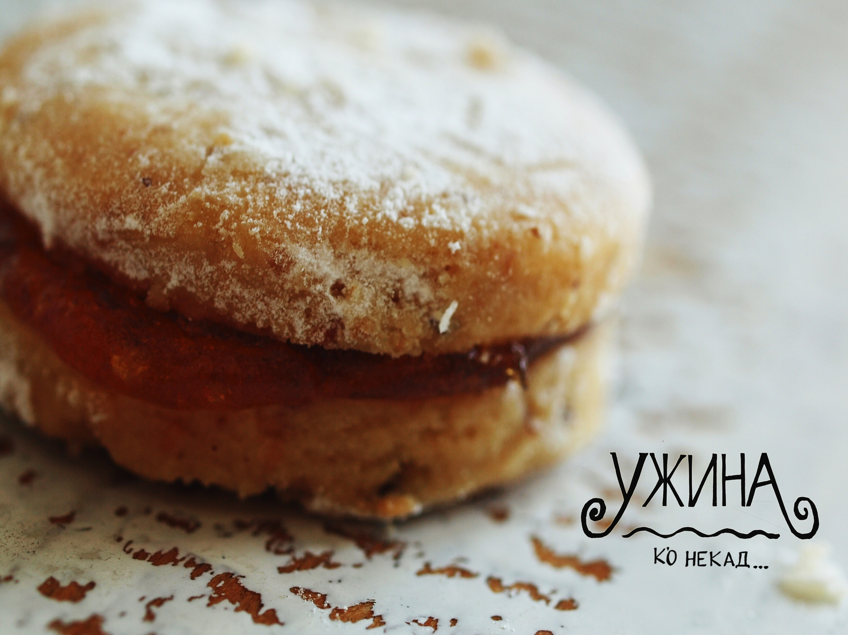

Slide 2
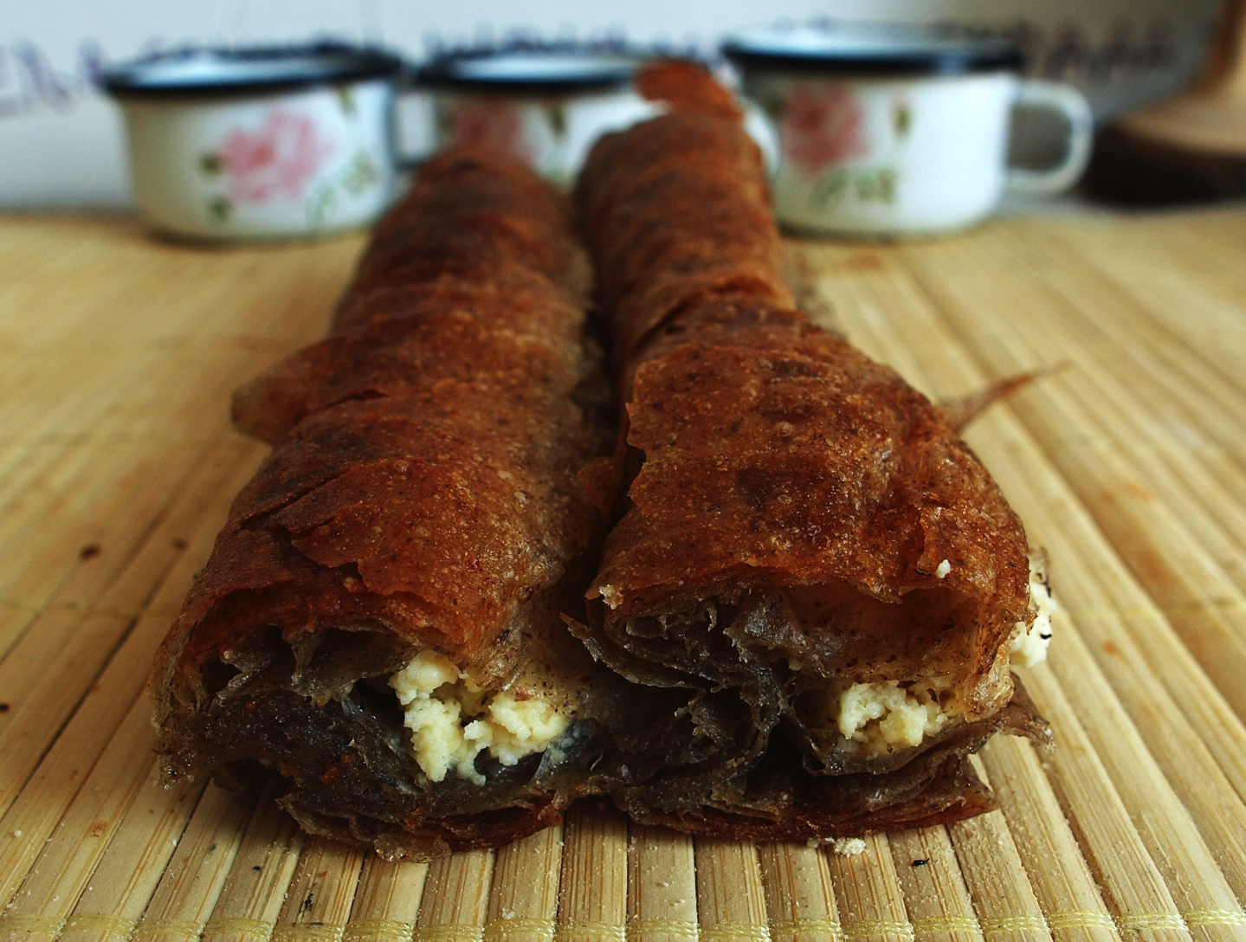
1
Cheese pie (Buckwheat crust)
Traditional Serbian cheese pie made with Buckwheat crust.
It is one of the most selling products in Užina.
The main difference is that it is made with Buckwheat crust,
because we are planning to have more organic and healthy
products in Užina Ušće Shopping center.

Slide 3
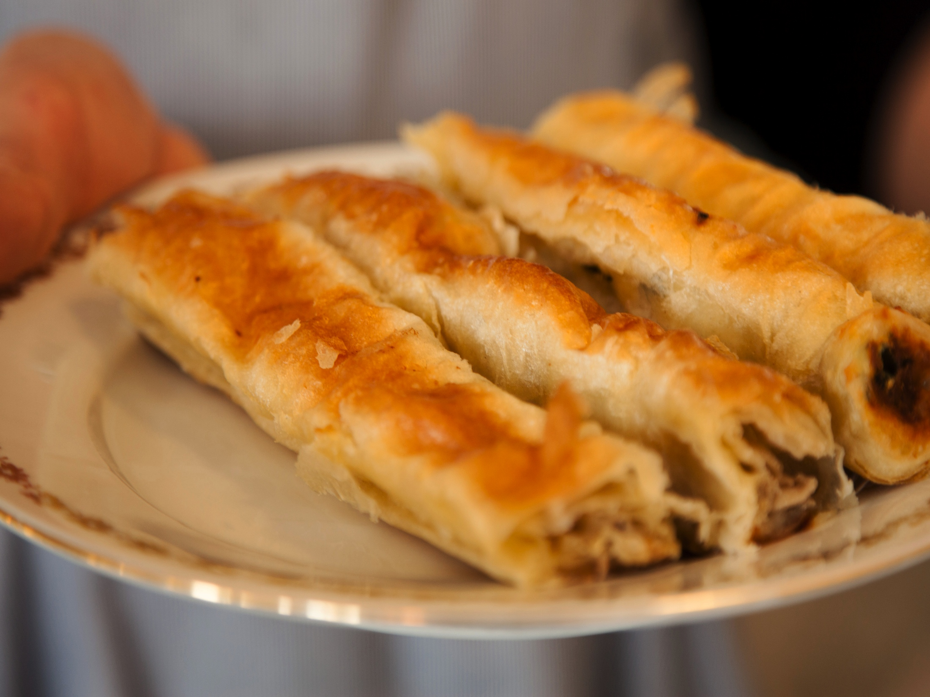
2
Chicken paprika pie (Corn crust)
Chicken pie is original recipe by Užina. It is made with chilly paprika, sesame and sour cream. Corn crust is ingredient which makes this pie more different then other pies Užina has.
Notes:
Chicken paprika pie (Corn crust) 115din – 100gr

Slide 4
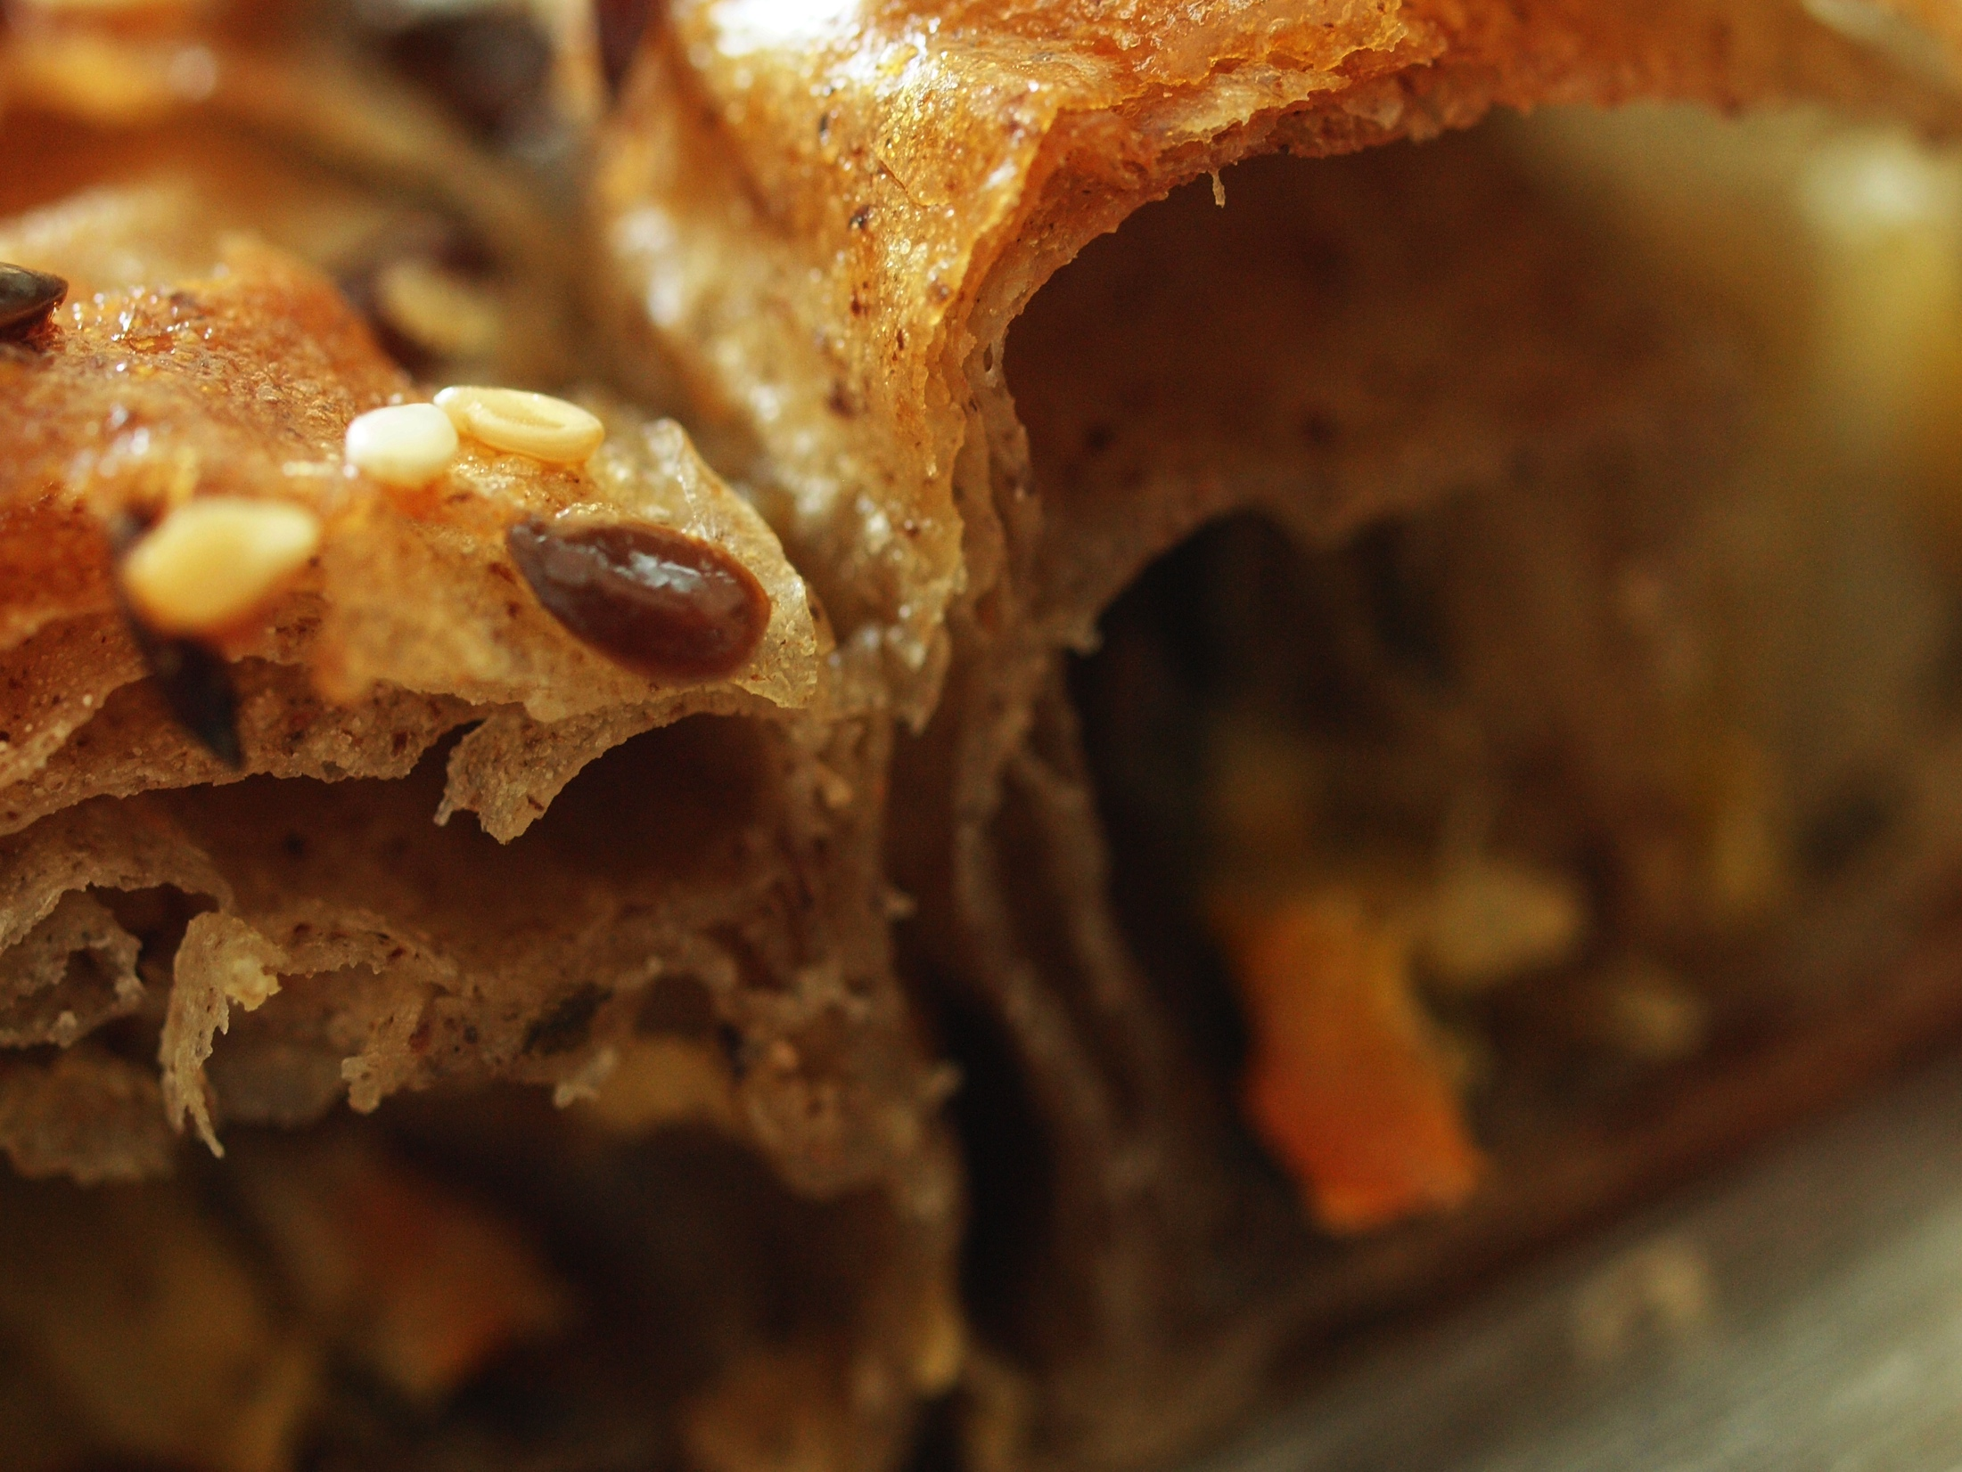
3.
Spring pie (Buckwheat crust) 95din – 100gr
This is the first pie made by Uzina recipe . Healthy pie. Celery, Spinach, Carrots, Leek, Pumpkin seeds, Sunflower seeds and sesame. This is our best selling pie.
3
Spring pie
(Buckwheat crust)
This is the first pie made by Užina recipe. Healthy pie. Celery, Spinach, Carrots, Leek, Pumpkin seeds, Sunflower seeds and sesame. This is our best selling pie.

Slide 5
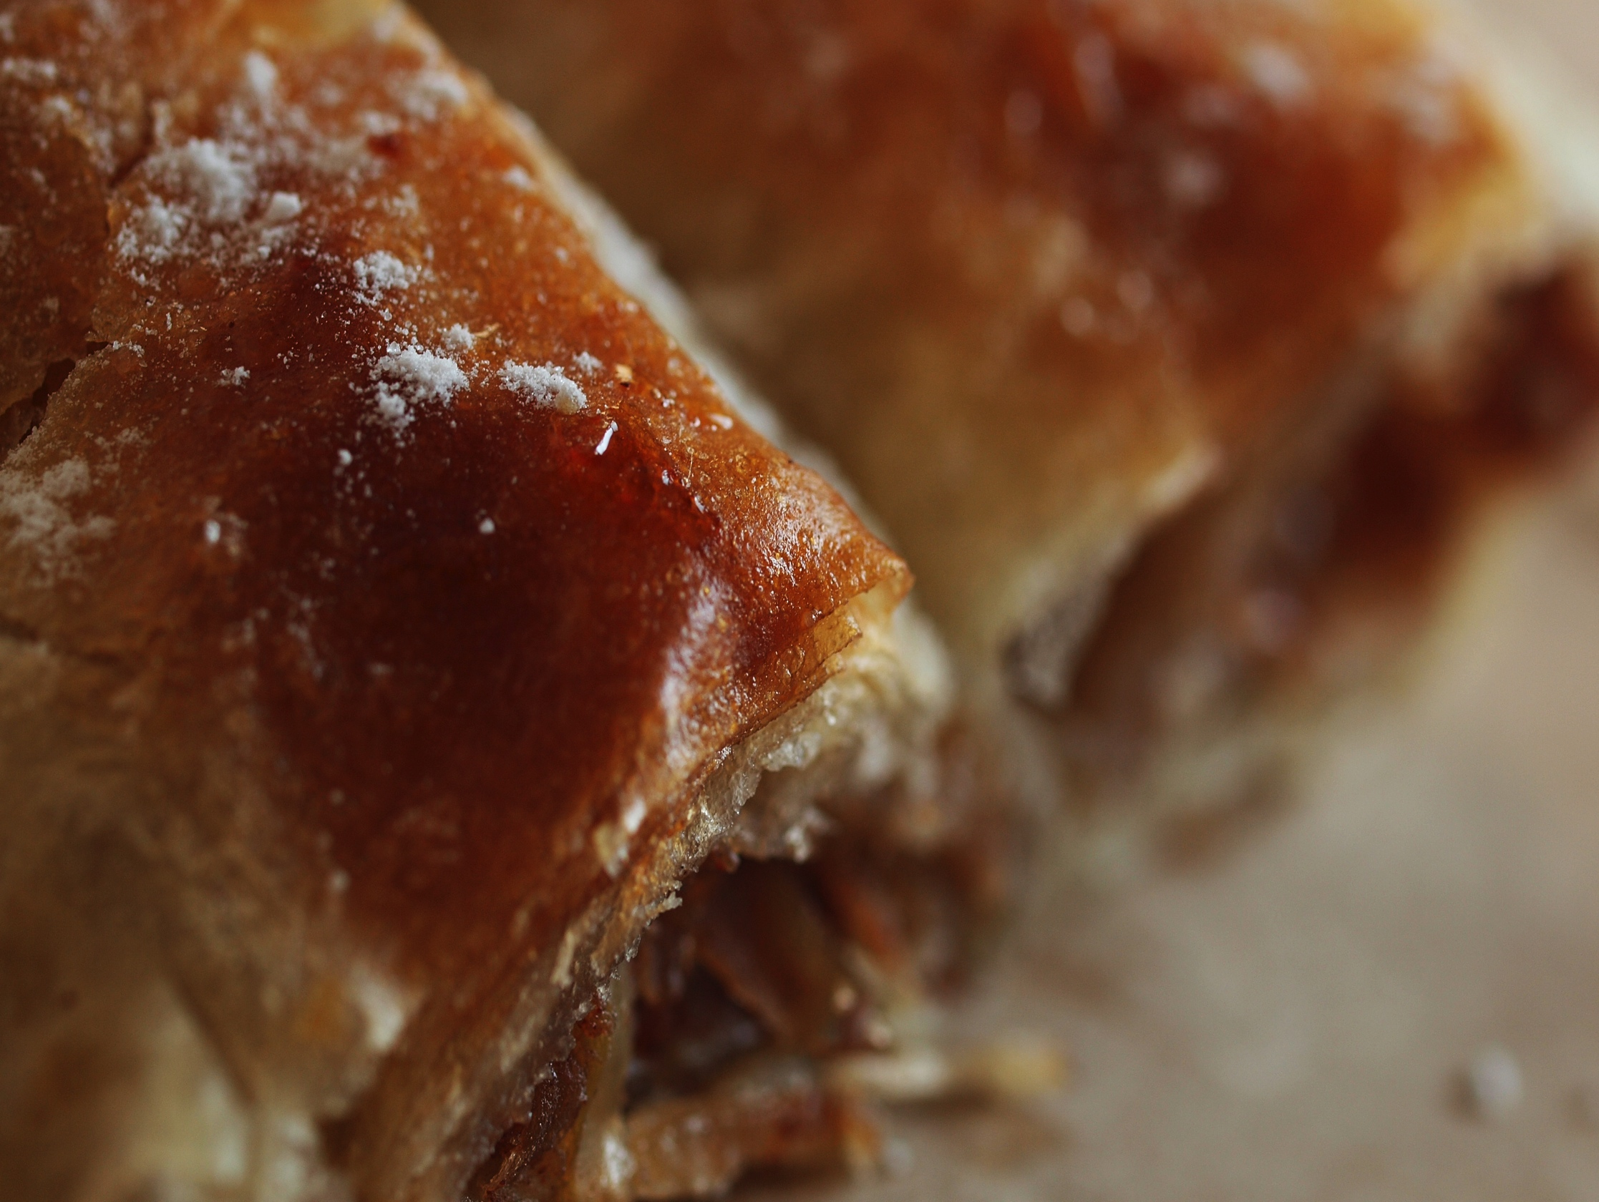
4
Apple pie
Traditional apple pie. Old Serbian recipe.

Slide 6
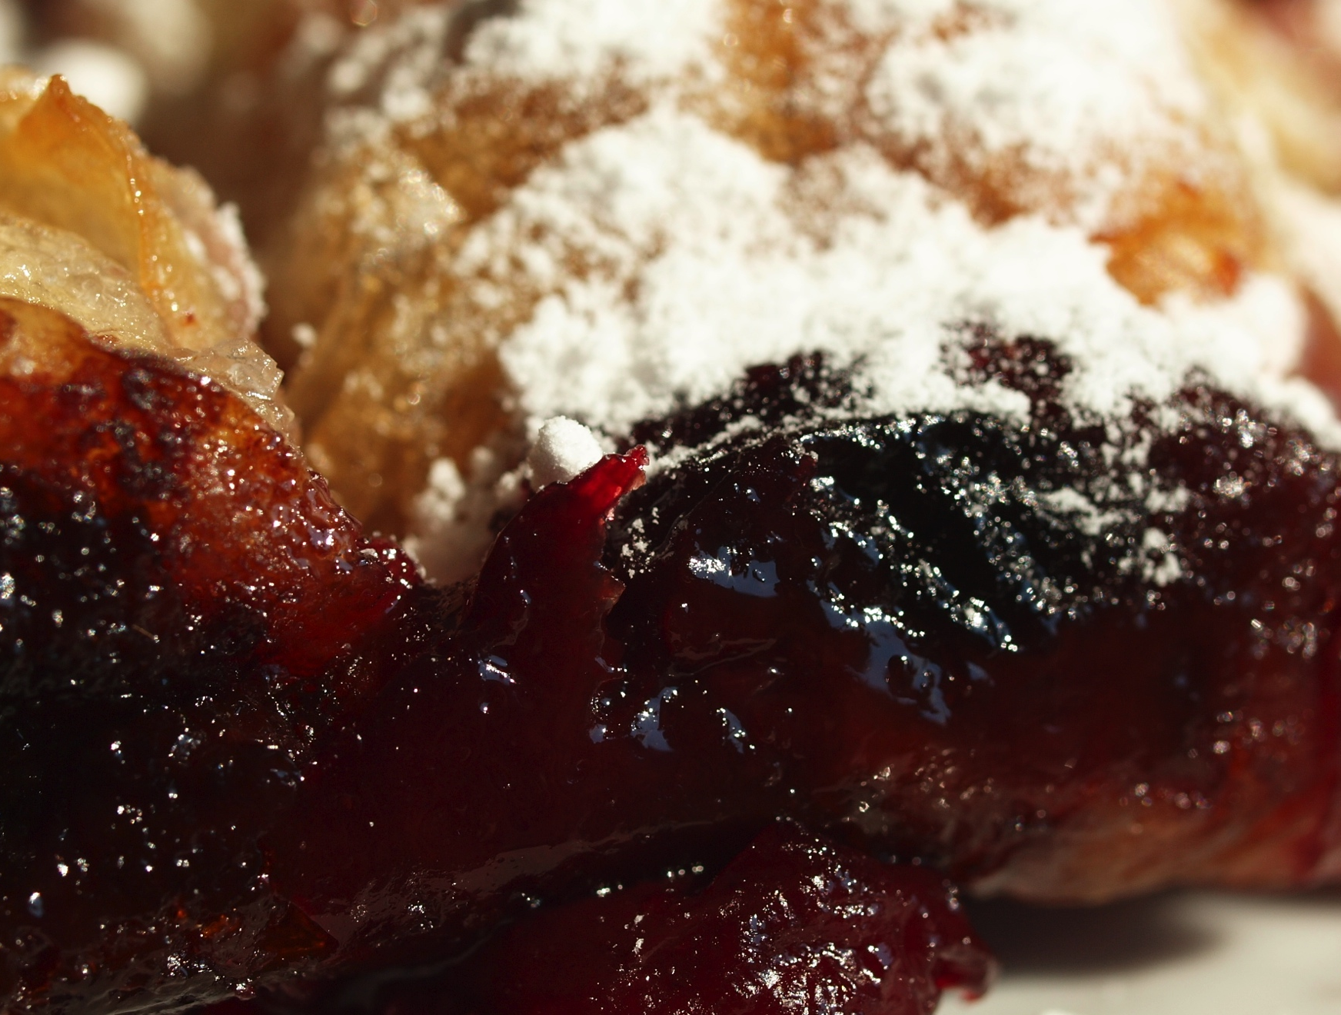
5
Cherry pie
Traditional cherry pie. Old Serbian recipe.

Slide 7
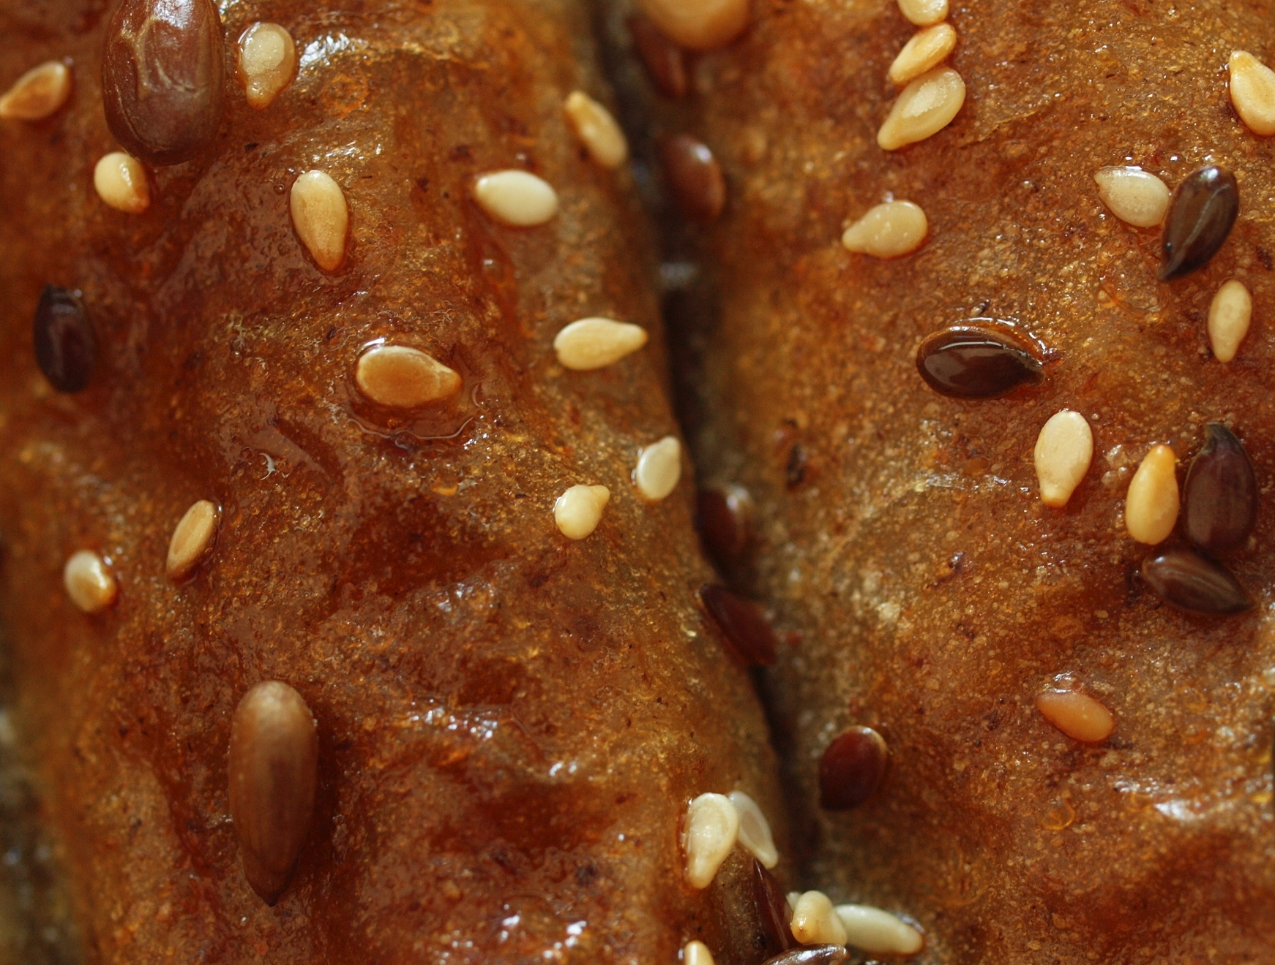
6
Goat cheese pie (Buckwheat crust)
Goat cheese pie is made by recipe that we got from our friend from Switzerland. It is made with cheese, rocket and spices rolled in Buckwheat crust.

Slide 8
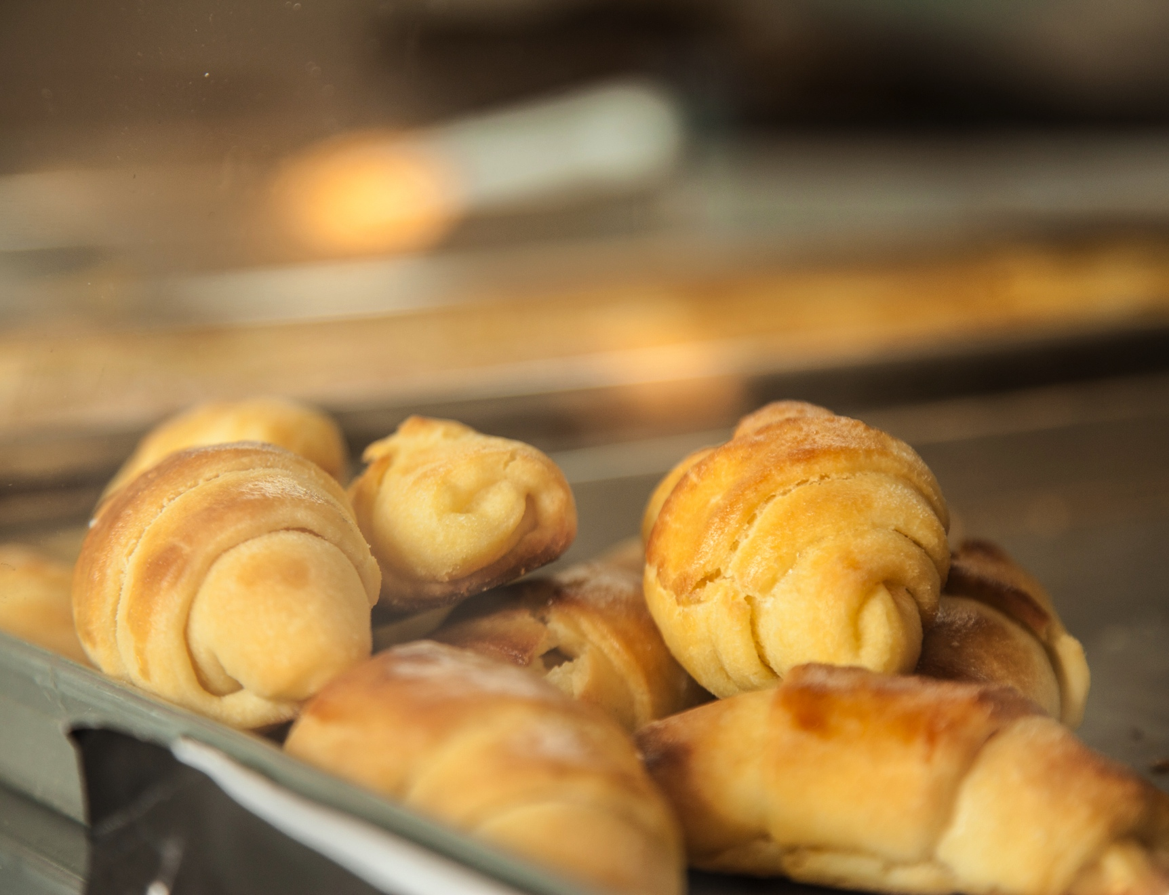
7
Homemade rolls with cheese
Grandma's old recipe made with regular flour and cheese.

Slide 9
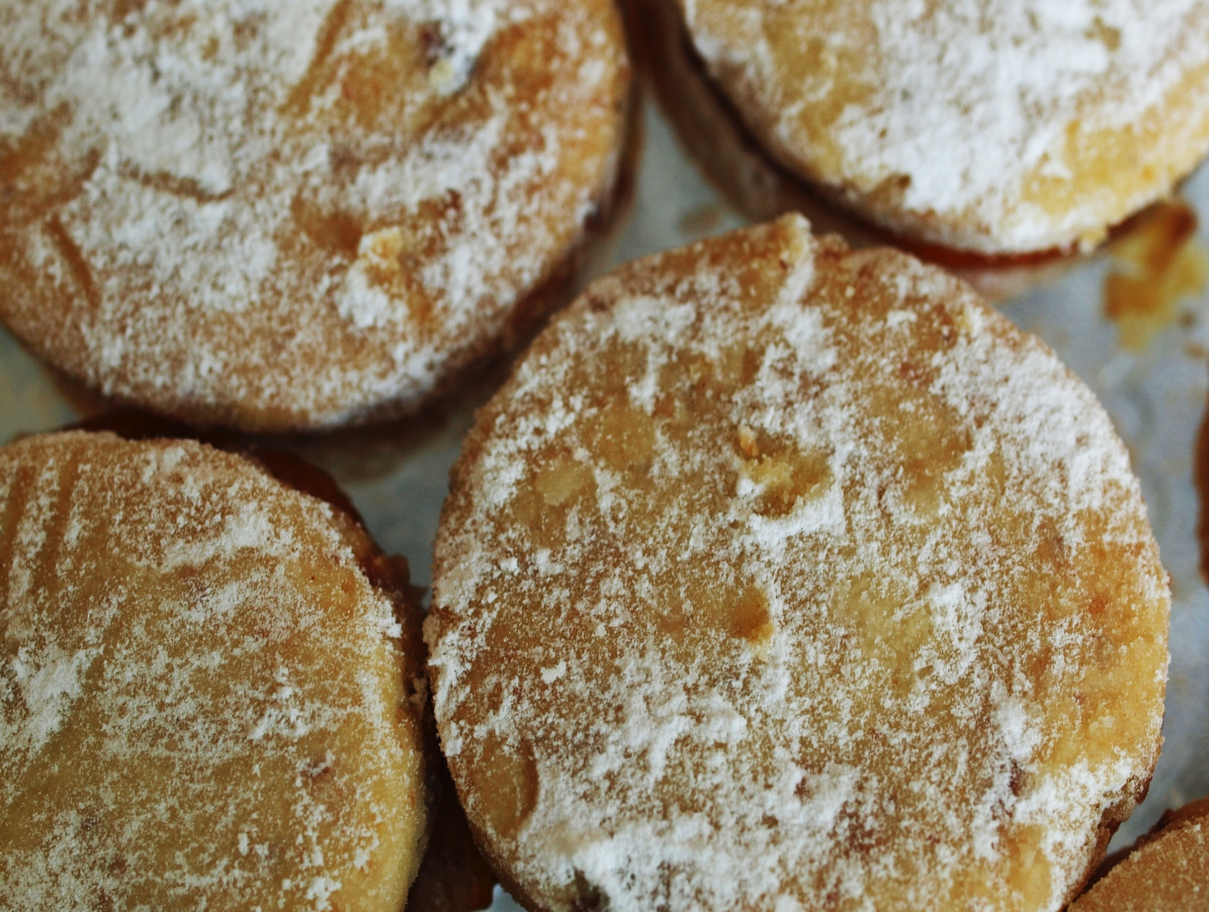
8
Traditional jam-filled cookies
(Vanilice)
These cookies have big tradition in Serbian cuisine. These are rare to find in stores, because it takes a lot of time to make them.

Slide 10
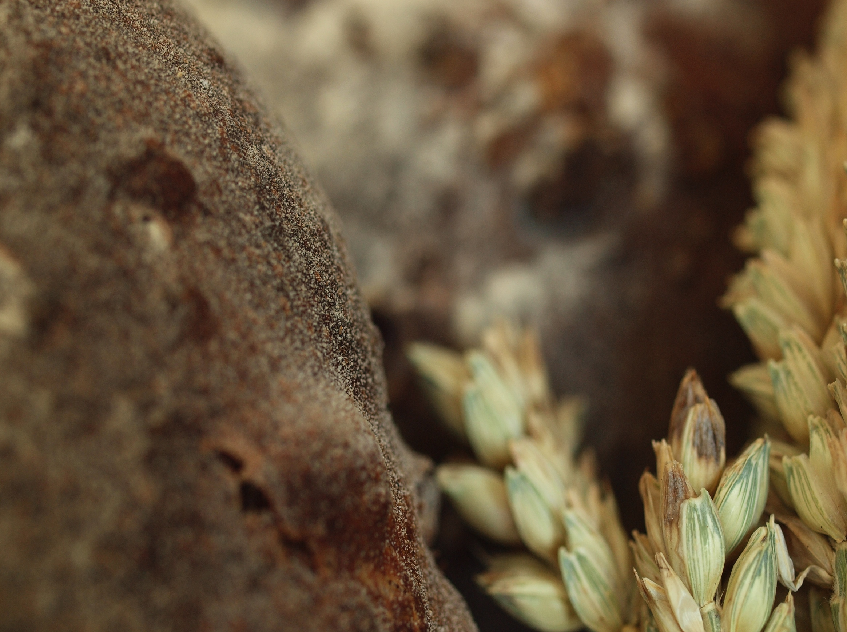
9
Porkiz
First and only sandwich made in Užina. Inspiration for the same came from USA. Pork meat is cooked in slow cooker for 6 hours, than same meat is freed from fat. Cooked again with spices for 2 hours. Beside meat, ingredients are Mustard with spices, rocket and raspberry jam. All together served in Kaiser bread.

Slide 11
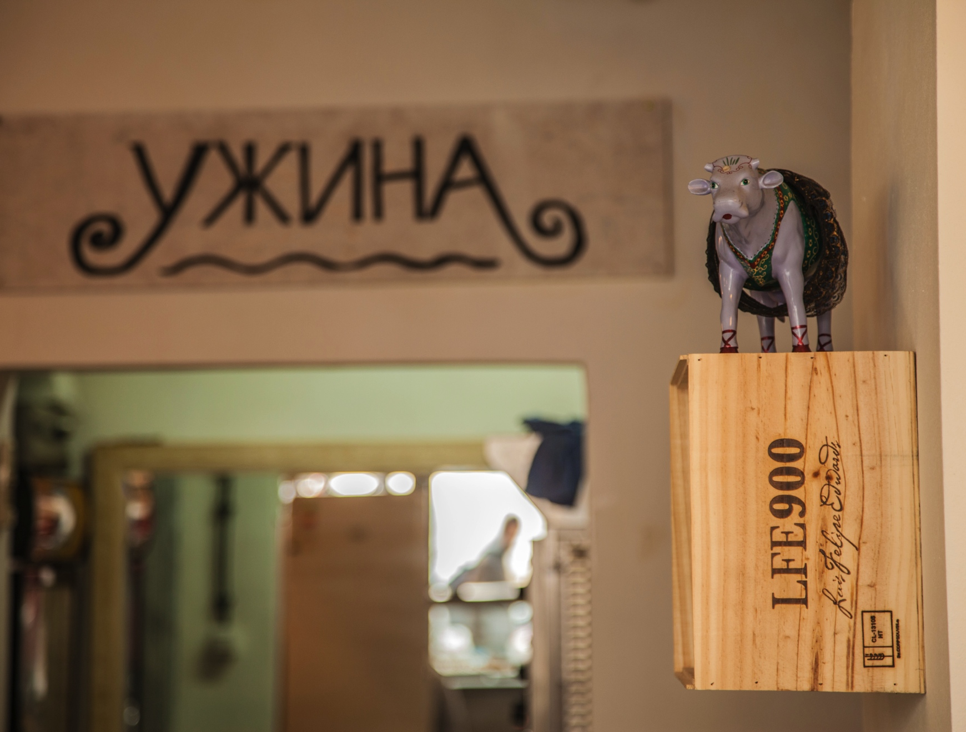
Owners:
Vesna Orović
Dejan Nikolić
Kosovska 35, Belgrade.

